Slide 1
Cell Organelles
Structure & Function

Slide 2
What is an Organelle?
All cells have small bodies within them called organelles
Organelles have specific functions much like organs in our body
Animal cells include:
Cell membrane
Nucleus
Cytoskeleton
Mitochondria
Endoplasmic reticulum
Golgi apparatus
Lysosomes

Slide 3
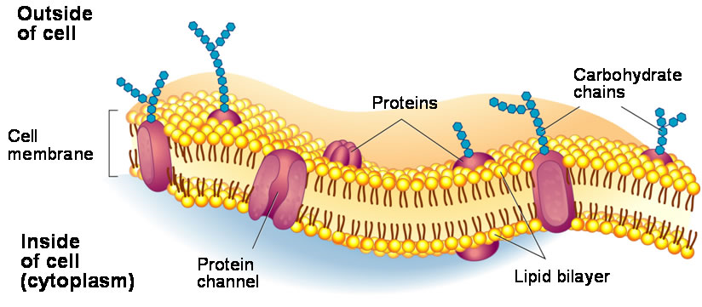
Cell membrane
Made up of lipid bilayer
The cell membrane protects the cell and allows proteins into and out of the cell
Think of a plastic bag…

Slide 4
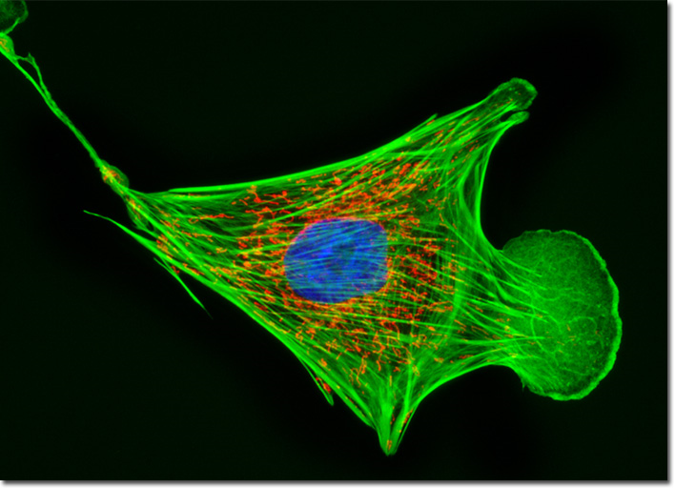
Nucleus
The control center of the cell – like the brain
It helps control eating, movement, and reproduction
Houses the DNA
Think of an air traffic control tower…

Slide 5
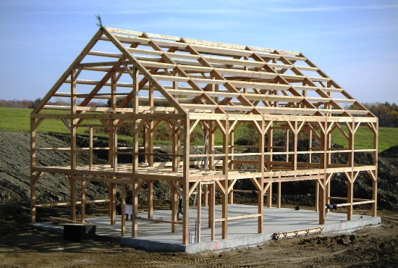
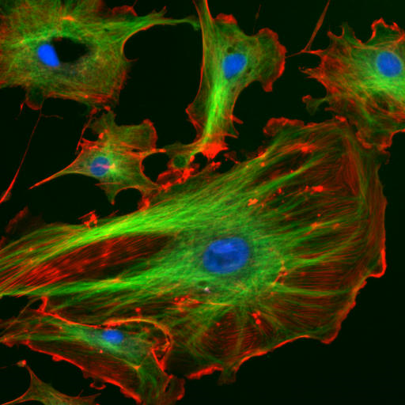
Cytoskeleton
Made up of thin fibers which provides the structure of the cell
Other organelles may attach to the fibers of the cytoskeleton and travel throughout the cell
Think of the frame of a house…

