Slide 1
Characteristics of Living Things

Slide 2
Objective
By the end of this lesson, students will be able to characterize a number of different items as biotic/living or abiotic/non-living by completing a chart and using evidence from their PowerPoint notes to support their claims.

Slide 3
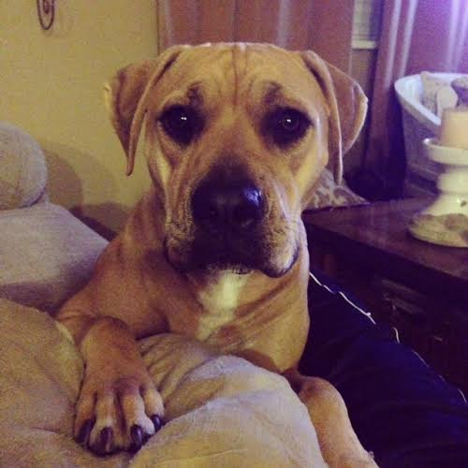
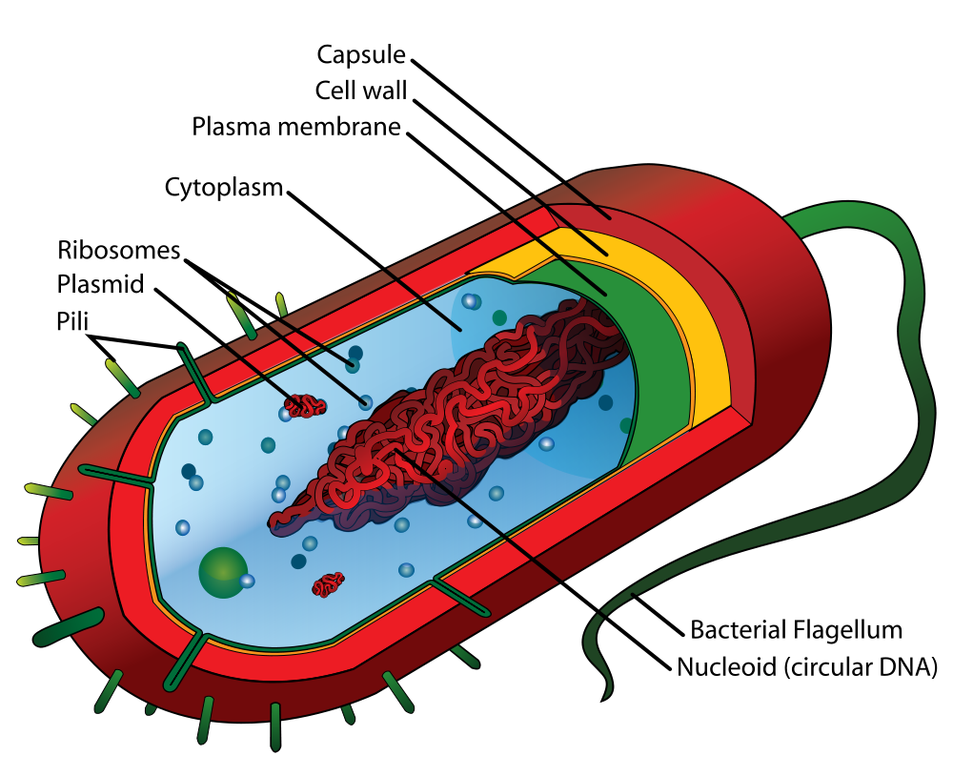
Characteristic 1
All living things are made up of cells
Single cell – Have everything they need to be self-sufficient
Multicellular – many cells working together

Slide 4
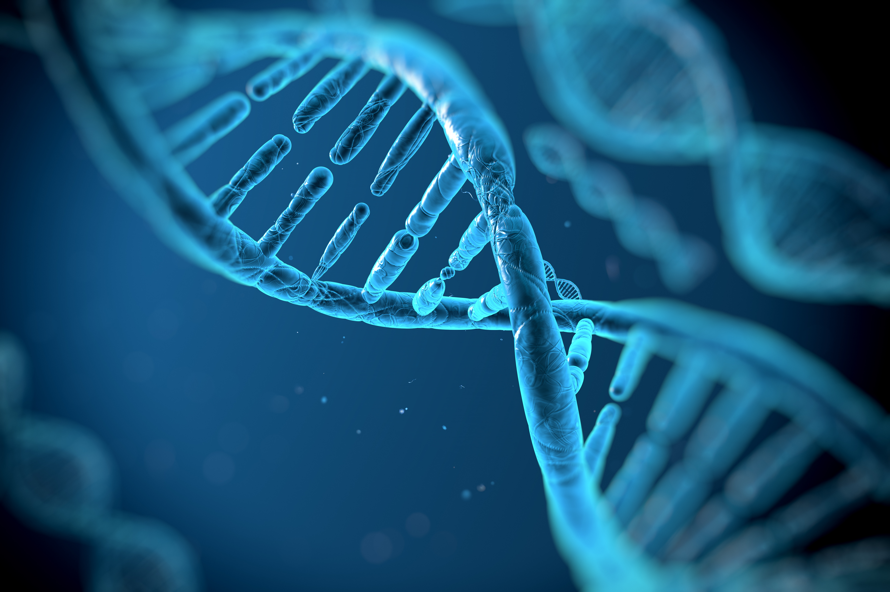
Characteristic 2
Living things have DNA
All cells contain the molecules deoxyribonucleic acid, or DNA
DNA carries instructions for the organisms traits

Slide 5
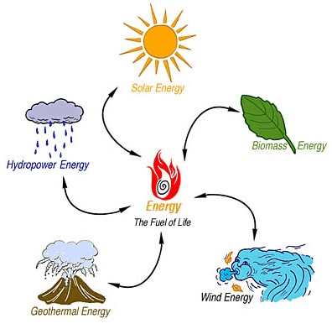
Characteristic 3
Living things use ENERGY
Living things take in energy and use it for maintenance
and growth.

Slide 6
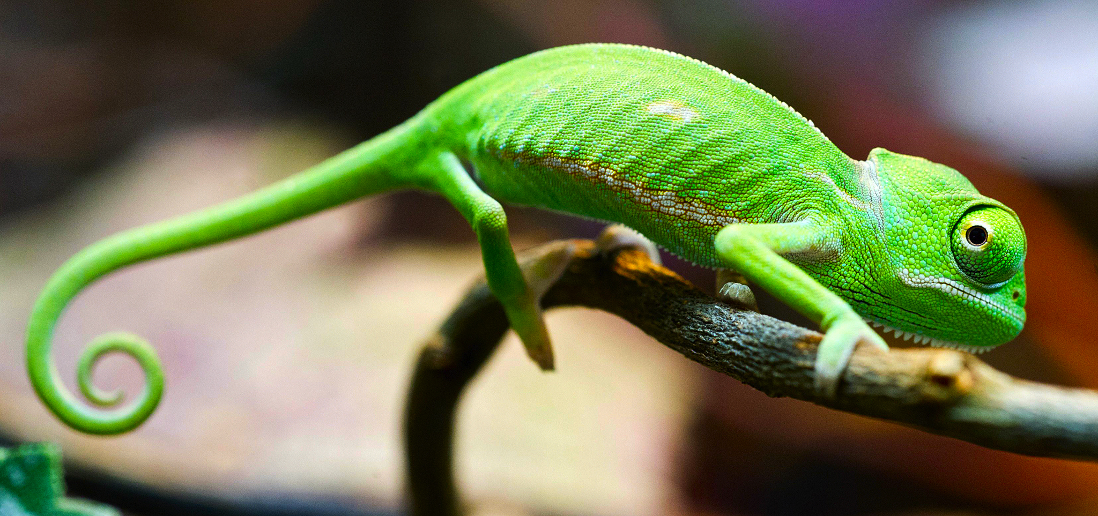
Characteristic 4
Living things respond to their environment
Living things will make changes in response to a stimulus in their environment.
A behavior is a complex set of responses.

Slide 7
Characteristic 5
Living things grow
Cell division - the formation of new cells.
Cell enlargement - the increase in size of a cell. Cells grow to a certain size and then divide.
An organism gets larger as the number of its cells increases.

Slide 8
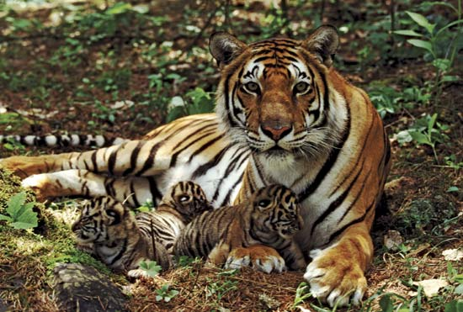
Characteristic 6
Living things reproduce
All living things reproduce in one of the following ways:
Asexual reproduction - Producing offspring without the use of gametes.
Sexual reproduction - Producing
offspring by the joining of sex cells.

Slide 9
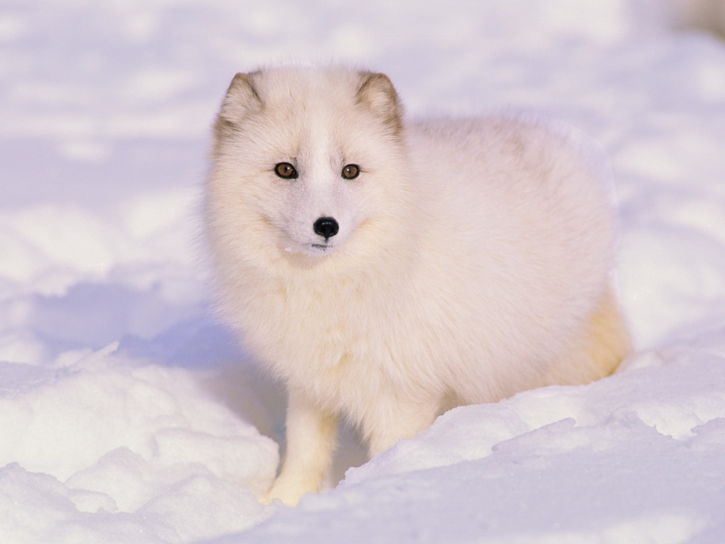
Characteristic 7
Living things adapt to their environment
Adaptations are traits giving an organism an advantage in a certain environment.

Slide 10
Let’s Revisit Our Work…
Now that we have learned about the characteristics of living things, re-organize your items into two lists: Biotic/Living or Abiotic/Non-living.
Support your answer using evidence from your PowerPoint notes
Use the following sentence frame to write your responses:
“_____________ is a(n) abiotic/biotic item/factor because according to the characteristics of living things _________________.”

Slide 11
Example: Wood Using our sentence frame…
The block of wood is an abiotic item because according to the characteristics of living things, it is not able to reproduce, does not use energy, and does not respond to a stimulus in the environment.

Slide 12
Part 3:
Choose 3 items from your tub to complete 3 sentences using this frame,
“_____________ is a(n) abiotic/biotic item/factor because according to the characteristics of living things _________________.”
Be ready to discuss your claims with the class!

Slide 13
All 7 Characteristics
All living things are made up of cells
Single cell
Multicellular
Living things have DNA
Living things use ENERGY
Living things respond to their environment
Living things grow
Cell division
Cell enlargement
Living things reproduce
Asexual reproduction
Sexual reproduction
Living things adapt to their environment

