Slide 1
Qualitative vs. Quantitative Data
7th Grade Life Science

Slide 2
Data in Science
In science, there are two types of data that we analyze.
Qualitative
Quantitative

Slide 3
Qualitative Data
Qualitative data deals with descriptions
Data can be observed, but not measured
Examples: colors, tastes, textures, smells, appearance, beauty etc.

Slide 4
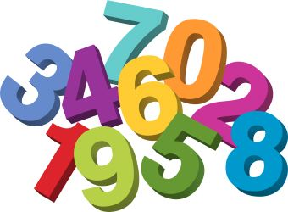
Quantitative Data
Deals with numbers
Data which can be measured
Examples: length, height, width, weight, volume, speed, time, temperature, cost etc.

Slide 5
Lets Practice: Qualitative Data
Write down as much qualitative data as you can about the following photo (use complete sentences). Remember your definition for qualitative data…

Slide 6
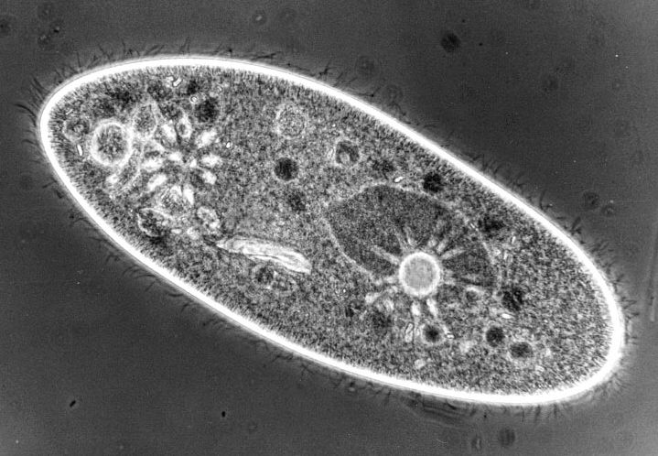
Lets Practice: Qualitative Data
In science, you will have to re-draw objects, especially when using microscopes. You need to be able to accurately represent your drawing in as much detail as possible.
Re-draw the following image and add your qualitative data (descriptions) under your drawing.

Slide 7
Lets practice: Quantitative Data
Object | Height (inches) | Weight (pounds)
Object 1 | 42 | 105
Object 2 | 65 | 175
Object 3 | 38 | 85
Object 4 | 45 | 110
Using your definition of quantitative data, answer the following questions…
What is the average height of all objects combined?
What is the average weight of all objects combined?

Slide 8
Lets Practice: Collect your own Quantitative Data
Collect your own set of quantitative data using anything in the room!
Example: The number of boys in the room versus the number of girls in the room (HaHa – this example is gone … you can’t use it!! ☺ )

