Slide 1
Human Anatomy
FEMALE

Slide 2
Rules To Abide by during this unit
Maturity matters
Scientific language may be used only
Questions? can be asked or written down

Slide 3
Female anatomy

Slide 4
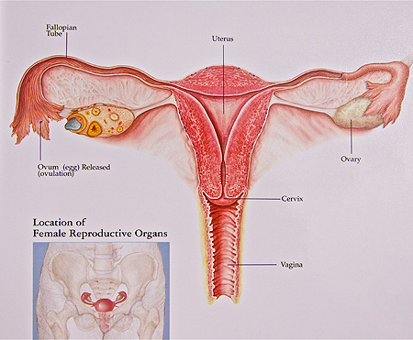
vagina
Hollow, muscular organ
connects the cervix of the uterus to the vulva and exterior of the body
Functions:
as an organ of sexual intercourse
serves as birth canal
serves as an exit for menstrual flow

Slide 5
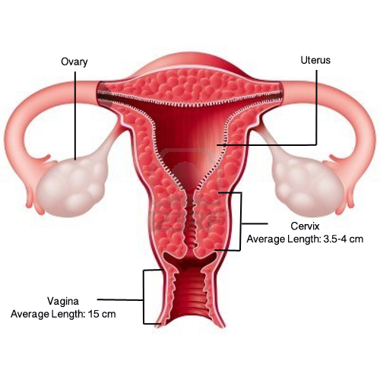
cervix
The narrow passage at the opening of a woman’s womb
Base of the uterus which projects into vagina
The opening in the cervix allows the sperm
to enter the uterus, and fetus to
exit during labor.

Slide 6
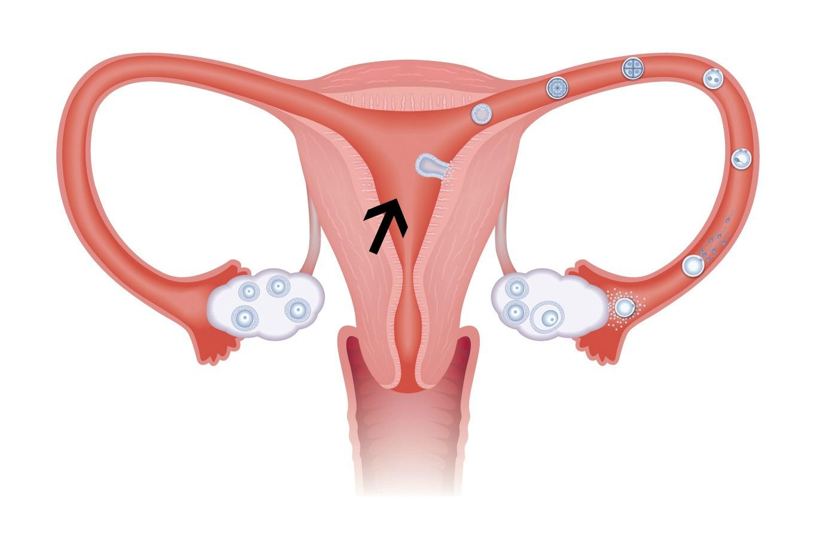
Uterus (womb)
Located in the female pelvis
Hollow, thick-walled, inverted
pear shaped muscular organ
Opens into vagina through a narrow
cervix
Receives, retains, and nourishes the
fertilized egg
Houses developing fetus before it is born

Slide 7
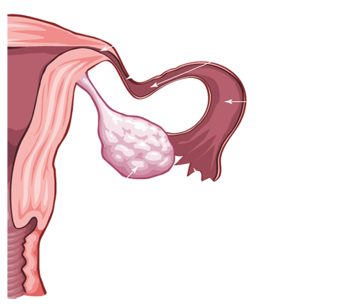
Fallopian tube (Oviduct)
The tube that leads from an ovary to the uterus
Transports eggs to the uterus
Finger-like projections (fimbriae)
at the end of the tube help move
the oocyte into the oviduct
Site of fertilization
Fallopian Tube

Slide 8
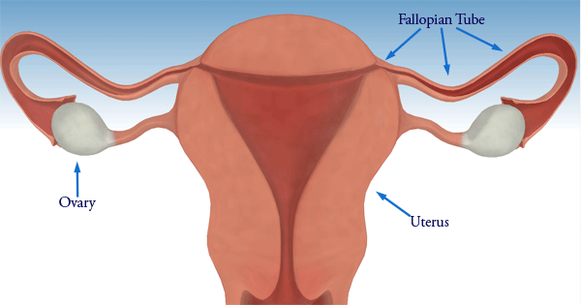
Ovary
Two, almond-shaped
Located in the lower abdomen
Produce eggs and sex hormones
Eggs mature near the surface of the ovaries

Slide 9
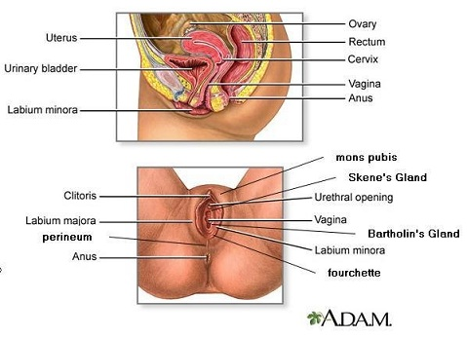
Different View of the female anatomy

Slide 10
https://youtu.be/WGJsrGmWeKE
https://youtu.be/nLmg4wSHdxQ (Look at this all the way through)
BrainPOP: Reproductive System (before starting or after male presentation)
Notes:
LAST LINK IS KHAN ACADEMY, MAY BE TOO GRAPHIC AFTER MIN 8?

