Slide 1
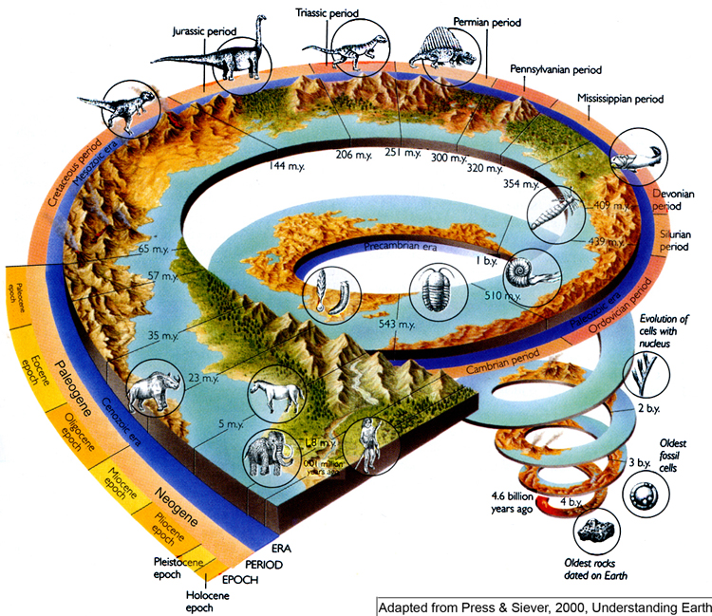
Geologic Time

Slide 2
Lecture, Class Discussions, Presentations
C – Speaker Voice Level 3; Listener Voice level 0
H – Raise your hand using appropriate hand signals and wait to be called on.
A – Lecture, Class Discussions, Presentations
M – NONE
P – Eyes watching, Ears listening, Facing the presenters, ready to offer feedback; SLANT
S- Success

Slide 3
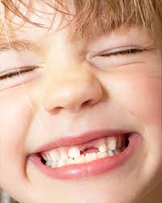
Hook
Events in Your Life
Place these events in order from 1 (earliest) to 8 (latest)
_____ when you started 2nd grade
_____ when you were born
_____ when you started kindergarten
_____ when you learned to ride a bike
_____ when you learned to walk
_____ when you learned to read
_____ when you lost your first tooth
_____ today’s date

Slide 4
Hook
In the middle of the chart (numerical time) record today’s date as zero. Then think of the number of years ago each event happened. Write these numbers in the column in front of each event.
Sequential time can be used to identify relationships between when different things occurred. For instance, I started kindergarten before I learned to ride a bike, but after I learned to walk
Time Interval | Numerical Interval | Sequential Order
When you started 2nd Grade
When you were born
When you started Kindergarten
When you learned to ride a bike
When you learned to walk
When you learned to read
When you lost your first tooth
Todays date

Slide 5
Internet Lecture
http://www.ucmp.berkeley.edu/education/explorations/tours/geotime/gtpage1.html

Slide 6
Lecture, Class Discussions, Presentations
C – Speaker Voice Level 3; Listener Voice level 0
H – Raise your hand using appropriate hand signals and wait to be called on.
A – Lecture, Class Discussions, Presentations
M – NONE
P – Eyes watching, Ears listening, Facing the presenters, ready to offer feedback; SLANT
S- Success

Slide 7
The Geologic Time Scale
The geologic time scale divides Earth’s 4.6 billion-year history into distinct intervals of time. Each interval is distinct because life and environmental conditions have changed throughout Earth’s history.

Slide 8
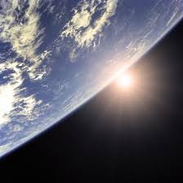
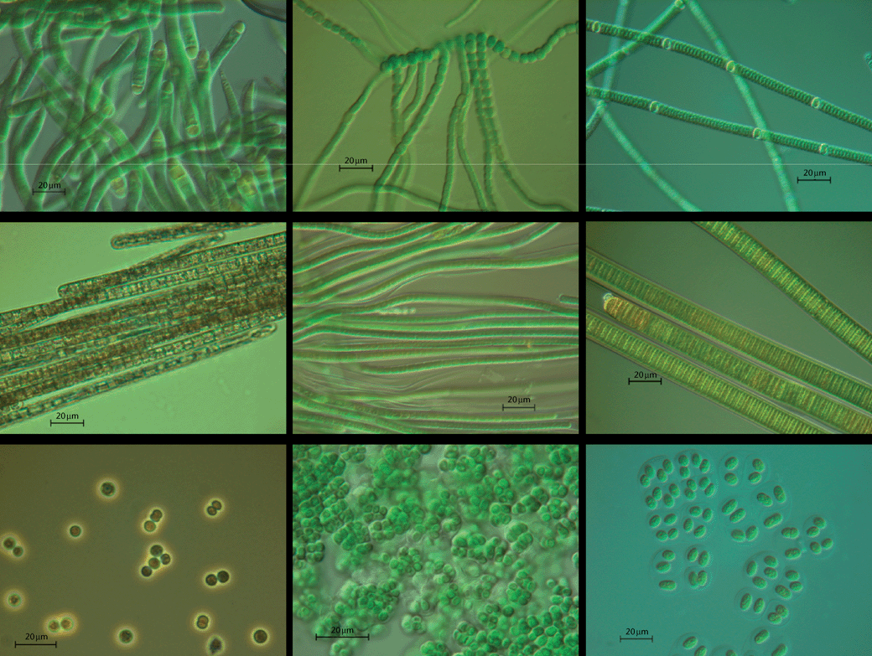
Precambrian Time
Time from the formation of Earth: 4.6 bya - 542 mya.
Early atmosphere did not contain oxygen like today.
Intense radiation from the sun bombarded Earth’s surface.
First organisms appeared in
oceans 3.6 bya – prokaryotes.
(What are prokaryotes?)

Slide 9
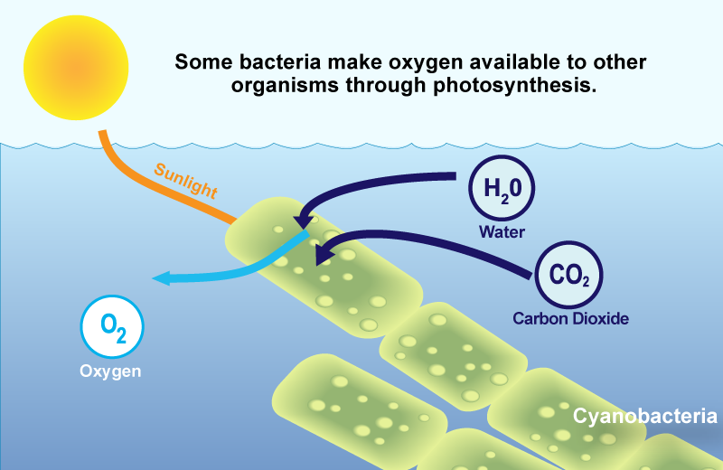
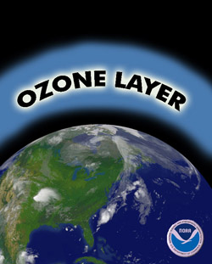
Precambrian Time
Cyanobacteria were one of the first prokaryotes on Earth.
Cyanobacteria used sunlight to produce
oxygen through photosynthesis.
This oxygen was released into the ocean and atmosphere therefore oxygen began to accumulate in the atmosphere.
Oxygen formed a new layer of gas, ozone, which absorbs harmful gases and reduced radiation
allowing life on Earth.

Slide 10
Understanding Check

Slide 11
Review Questions
What where the first types of organisms to appear during the Precambrian Era?
Why were they so important during the Precambrian Era?

Slide 12
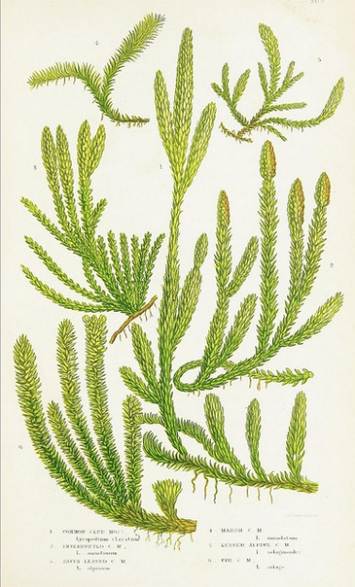
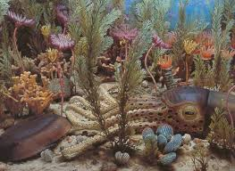
The Paleozoic Era (“Ancient Life”)
542 mya - 251 mya
The Cambrian Explosion
Marine life-forms appeared
Many new and more complex life-forms appeared
During the middle of this era, plants, fungi, and animals colonized land.
By the end of the era, forests of giant ferns,
horsetails, and conifers covered much of Earth.
No flowering plants existed yet.
Fossil records indicate arthropods were the first land animals

Slide 13
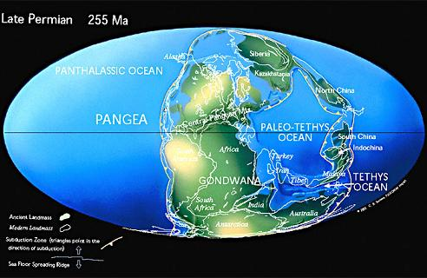
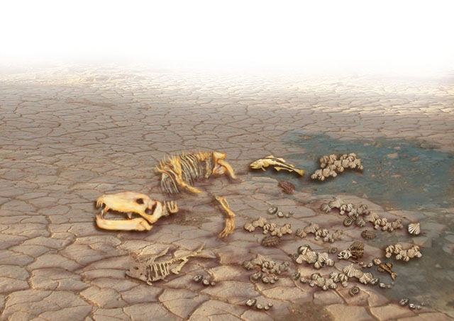
The Paleozoic Era (“Ancient Life”)
The largest mass extinction was the Permian extinction during this era.
Earth’s continents had formed Pangaea
and inland seas had disappeared.
90% of marine species and 78% of land species became extinct.
Fossil records shows groups of reptiles and amphibians survived.

Slide 14
Lecture, Class Discussions, Presentations
C – Speaker Voice Level 3; Listener Voice level 0
H – Raise your hand using appropriate hand signals and wait to be called on.
A – Lecture, Class Discussions, Presentations
M – NONE
P – Eyes watching, Ears listening, Facing the presenters, ready to offer feedback; SLANT
S- Success

Slide 15
Understanding Check

Slide 16
A, B, C, or D
The Cambrian Explosion included
A. Flowering plants only
B. Marine life only
C. Arthropods, marine life, and non- flowering plants such as horsetails, conifers, and ferns
D. Arthropods only

Slide 17
Review Questions
What groups of animals survived the extinction during the Paleozoic Era?
Can you think of any possible reasons for why they may have survived?

Slide 18
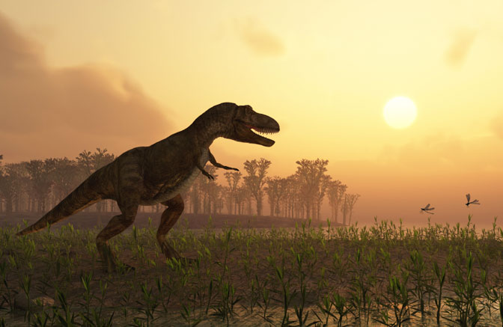
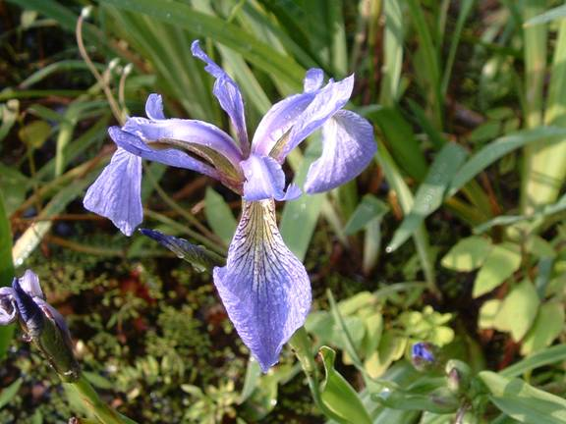
The Mesozoic Era (“Middle Life”)
Began 251 mya
Commonly referred to as the age of the reptiles
Dinosaurs dominated during this period
for approximately 150 million years
First birds and mammals appeared
Most important plants were conifers which formed large forests
Flowering plants appeared
later in the Mesozoic Era

Slide 19
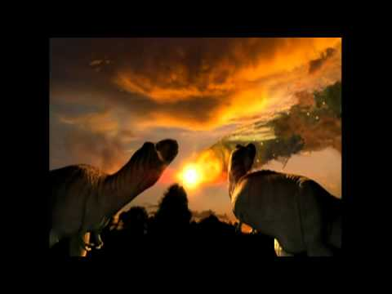
The Mesozoic Era (“Middle Life”)
Cretaceous-Tertiary Extinction
All of the dinosaurs and about 1/2 of the
animals and plant species became extinct
The disappearance of many types of fossils from the fossil record prove this mass extinction
Possible hypothesis: an object from our solar system hit Earth…
Impact → dust clouds → fires → blocked sunlight → plants died → no plants = no food for plant eating animals → no plant eating animals for meat eating animals → bye bye

Slide 20
Understanding Check

Slide 21
A, B, C, or D
The Cretaceous-Tertiary Extinction was responsible for …
Killing all dinosaurs from Earth and about half the plant and animal species present
Removing all dinosaurs from Earth
Killing all birds
Bye Felicia

Slide 22
Review Questions
Describe the hypothesis which states the reason why the mass extinction in this era occurred.

Slide 23
Lecture, Class Discussions, Presentations
C – Speaker Voice Level 3; Listener Voice level 0
H – Raise your hand using appropriate hand signals and wait to be called on.
A – Lecture, Class Discussions, Presentations
M – NONE
P – Eyes watching, Ears listening, Facing the presenters, ready to offer feedback; SLANT
S- Success

Slide 24
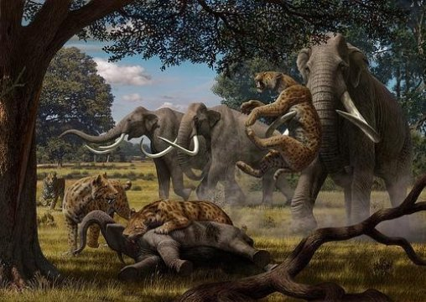
The Cenozoic Era (“Recent Life”)
65 mya - present
During Cenozoic Era, many mammals, birds, insects, and flowering plants appeared
The Age of Mammals
Early Cenozoic mammals were small forest dwellers
Larger mammals appear later and longer legs for running, teeth specialized for eating different types of foods, and larger brains.
Cenozoic mammals included mastodons, saber-toothed cats, camels, giant ground sloths and horses

Slide 25
Summary
The geologic time scale divide Earth’s 4.6 billion-year history into intervals.
At certain times in Earth’s history, the number of different kinds of organisms has increased or decreased.
Life on Earth developed more than 3.6 bya, during Precambrian time.
Marine life forms appeared at the beginning of the Paleozoic Era.
Dinosaurs dominated Earth during the Mesozoic Era. They became extinct during the Cretaceous-Tertiary extinction.
Mammals dominated the Cenozoic Era.

Slide 26
Understanding Check

Slide 27
A, B, C, or D
The Geologic Time Scale …
separates life on Earth into three areas.
divides Earth’s 4.6 billion-year history into distinct intervals of time.
gives us only minor details about fossils.
divides Earth’s 3.6 million-year history into distinctive intervals of time.

Slide 28
Review Questions
During the Cenozoic Era, what was so important for the development of mammals?
Where do humans fit in in the Geologic Time Line?

