Slide 1
human anatomy
MALE

Slide 2
RULES TO ABIDE BY
Maturity Matters
Scientific language only please (No Slang)
If you make others feel uncomfortable, you will be removed from the classroom and your parents will be called.
Questions…how to ask them
There is a box for questions if you do not feel comfortable asking whole class
Appropriate questions will be answered the next day

Slide 3
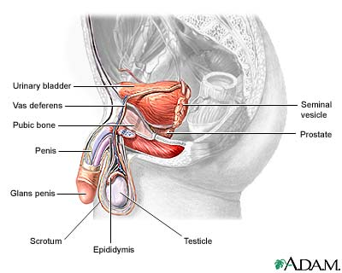
Male anatomy

Slide 4
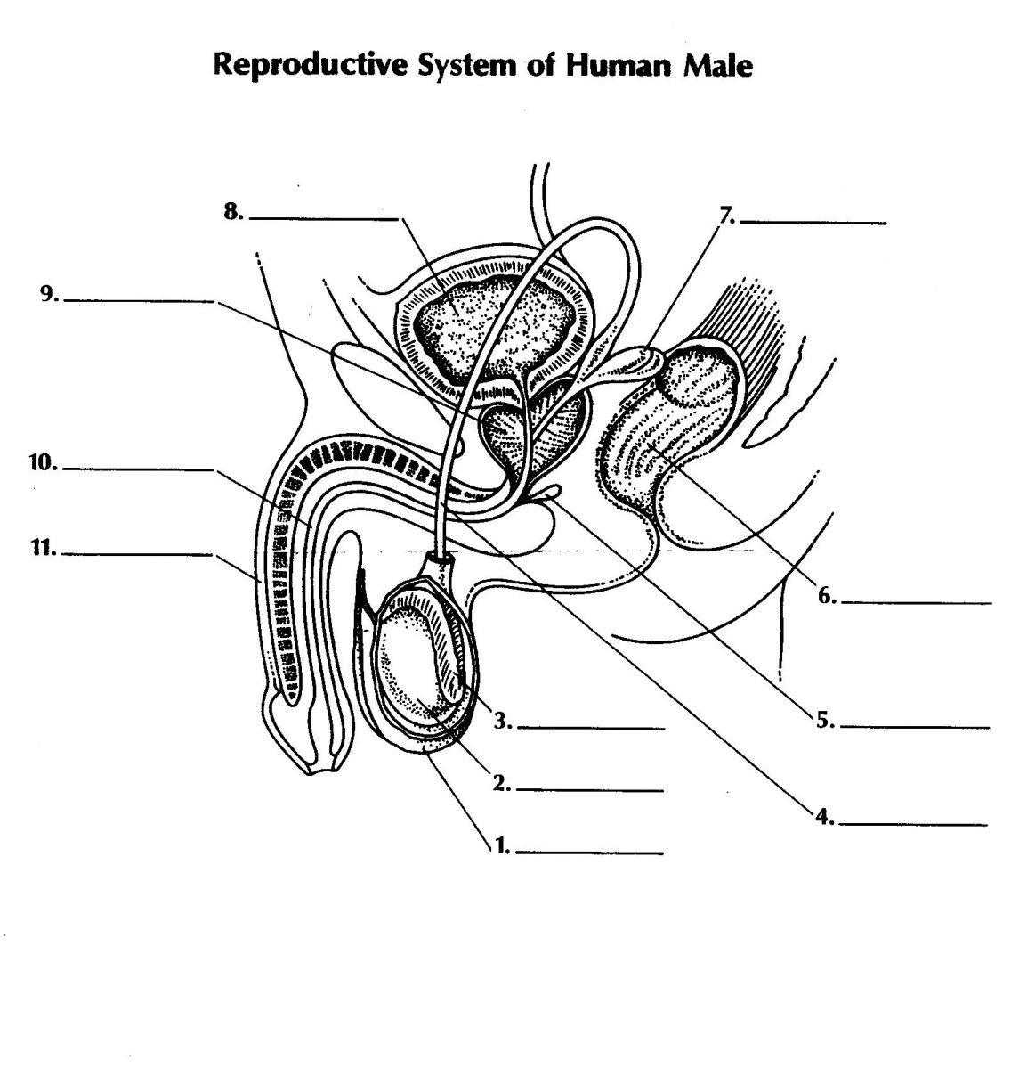
Penis
Erectile organ of sexual
intercourse​
Deposits semen into the
female vagina
Organ from urine and semen
are released (not at the same time)

Slide 5
testes
Produce sperm and sex hormones

Slide 6
scrotum
The bag of skin that contains the testes
Keeps the testes at the proper temperature
Externally located

Slide 7
epididymis
Site of sperm maturation
Store mature sperm

Slide 8
Vas deferens
Paired duct for sperm maturation, storage, and transport (carries sperm
from the epididymis to the ejaculatory duct)
Leads from the epididymis to the urethra

Slide 9
Ejaculatory ducts
Enter the urethra
These paired ducts are for
transporting sperm

Slide 10
urethra
Extends from the urinary bladder to the opening at the tip of the penis.
A passageway for sperm and fluids from the reproductive system and urine from the urinary system.
While reproductive fluids are passing through the urethra, sphincters contract tightly to keep urine from entering the urethra.

Slide 11
Seminal vesicles
Paired glands on the posterior base of the urinary bladder
Contribute nutrients and fluid to semen (fructose and seminal fluid)

Slide 12
Bulbourethral glands
Secretes mucus-containing fluid to semen

Slide 13
Videos
http://youtu.be/nr5W9trSv8I
http://study.com/academy/lesson/male-reproductive-system-external-anatomy.html

